Slide 1
WEEK 4
System Design(SD)(22CS024)
Bachelor of Engineering- Computer Science & Engineering
Department of Computer Science & Engineering
Chitkara University Institute of Engineering and Technology, Chitkara University, Punjab, India

Slide 2
Design Approaches in Software Engineering
Design approaches define how a software system is structured and built from specifications or requirements. They guide the transition from user needs to working code and typically include two main stages:
High-Level Design (HLD) – Architectural design, focusing on the system's structure.
Low-Level Design (LLD) – Component-level design, focusing on internal logic and implementation details.

Slide 3
1. High-Level Design (HLD)
High-Level Design outlines the overall architecture of the system. It breaks down the system into major modules or components and shows how they interact with each other.
Key Features:
Provides a bird’s-eye view of the system.
Defines system modules, data flow, and interfaces.
Specifies technologies, tools, and design patterns used.
Used by architects and senior developers to align design with requirements.

Slide 4
Deliverables:
System Architecture Diagrams
Module Diagrams
ER Diagrams (Entity-Relationship)
Technology stack decisions

Slide 5
2. Low-Level Design (LLD)
Low-Level Design dives into the details of each module defined in HLD. It explains how individual components will work internally.
Key Features:
Focuses on class design, method definitions, and business logic.
Specifies algorithms, data structures, and database schema.
Guides developers in the actual coding process.

Slide 6
Deliverables:
Class Diagrams
Sequence Diagrams
Pseudocode / Flowcharts
Database Table Definitions

Slide 7
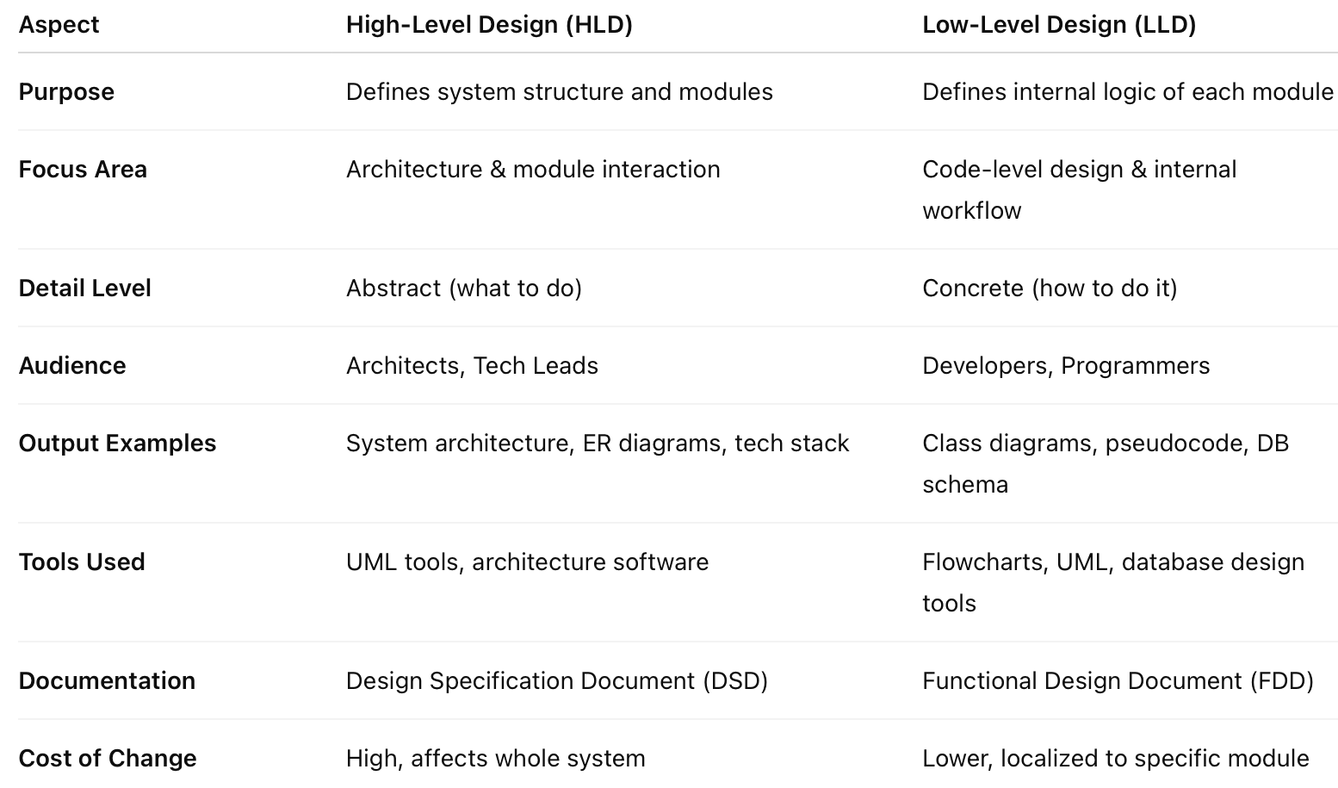
Comparison: High-Level Design vs Low-Level Design

Slide 8
Architectural Pattern
An Architectural Pattern is a reusable and general solution to a common problem in software architecture within a given context.
It provides a set of predefined subsystems, their responsibilities, and how they interact to solve architectural challenges.
Unlike a design pattern (which is more focused on solving smaller coding or design issues), an architectural pattern deals with high-level structures of software systems.
Architectural patterns help architects and developers organize software components, improve system quality attributes (like scalability, maintainability, performance), and provide a common vocabulary for designing complex systems.

Slide 9
Monolithic Architecture — a single unified codebase and deployment.
Microservices Architecture — a suite of independently deployable services.
Event-Driven Architecture — components communicate via asynchronous events.

Slide 10
1. Monolithic Architecture
In a monolithic architecture, the entire application is built as a single, unified unit. All components — user interface, business logic, data access — are tightly integrated and run as a single process.
Characteristics:
Single codebase and deployment unit.
Easy to develop and test in early stages.
Tightly coupled components.
Scaling means replicating the entire application.

Slide 11
Pros:
Simpler to develop initially.
Easier to test and deploy for small applications.
Less operational complexity.
Cons:
Hard to maintain and evolve as the application grows.
Difficult to scale individual components independently.
Deployment requires full application redeployment, increasing downtime risk.
Technology stack is uniform (hard to use different tech for different parts).

Slide 12
2. Microservices Architecture
Microservices break down an application into a collection of small, loosely coupled, independently deployable services. Each microservice corresponds to a specific business capability.
Characteristics:
Services communicate typically via, messaging, or RPC.
Each service has its own database or data management.
Each microservice can be developed, deployed, and scaled independently.
Technology heterogeneity allowed (different languages/frameworks per service).

Slide 13
Pros:
Easier to scale individual components.
Independent deployment reduces risk and speeds up release cycles.
Teams can work on different services independently.
Fault isolation; failure in one service doesn’t bring down the whole system.
Cons:
More complex to design and manage.
Requires robust service discovery, load balancing, and monitoring.
Distributed system challenges like network latency, data consistency.
More complex testing and debugging.

Slide 14
3. Event-Driven Architecture
Event-Driven Architecture (EDA) is a design paradigm where components communicate by producing and consuming events asynchronously. Events represent changes in state or significant actions.
Characteristics:
Loose coupling between event producers and consumers.
Components respond to events (messages) rather than direct calls.
Typically uses message brokers or event buses (e.g., Kafka, RabbitMQ).
Enables real-time, asynchronous processing.

Slide 15
Pros:
High scalability and responsiveness.
Decouples components, enabling independent evolution.
Good for applications with many asynchronous events (IoT, real-time analytics).
Fault tolerance through retries and event persistence.
Cons:
Increased complexity in event management.
Harder to ensure data consistency.
Debugging and tracing event flows can be challenging.
Requires careful design to avoid event storms or message loss.

Slide 16
THANK YOU

